Slide 1
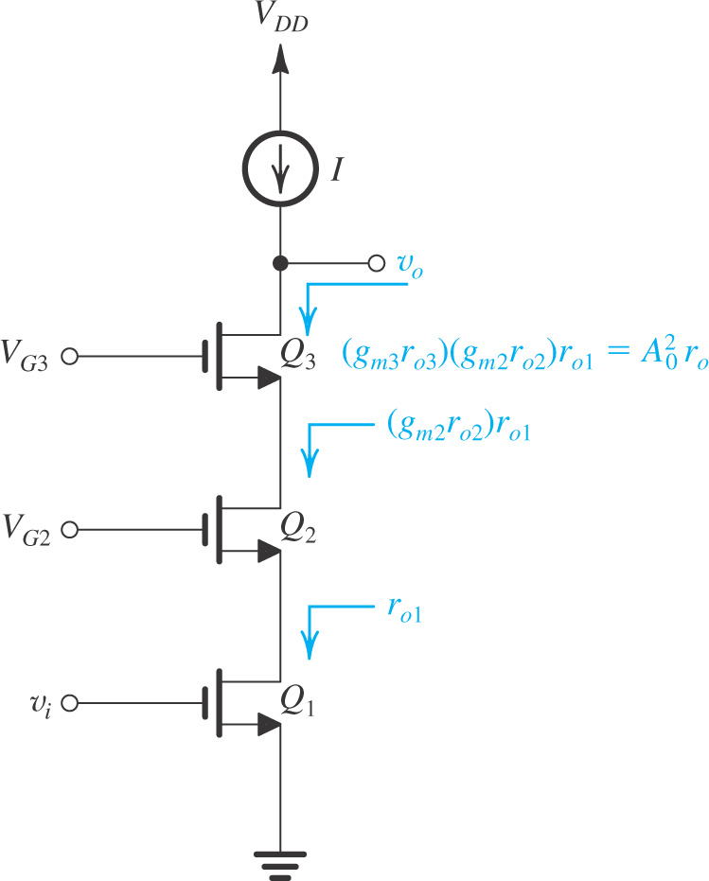

Double Cascoding
If still a higher output resistance and correspondingly higher gain are required, it is still possible to add another level of cascoding – as illustrated in Figure.
Observe that Q₃ is the second cascode transistor, and it raises the output resistance by (g_{m3}r_{o3}).
Even higher output resistance can be achieved in MOSFET circuits by double cascoding
Requires higher supply voltage as one more CG transistor is stacked in the gain stage
Double cascoding is required for the current-source load to realize the advantage in voltage gain
Figure: Double cascoding.
Drawback of double cascoding!

Slide 2
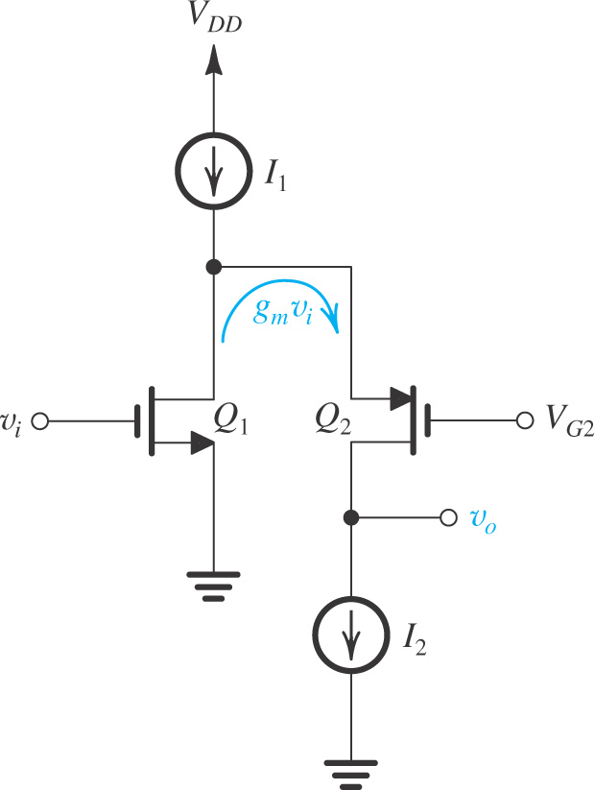
The Folded Cascode
To avoid the problem of stacking a large number of transistors across a low-voltage power supply, one may use a PMOS transistor for the cascode device – as shown in Figure.
This provides an alternative to the design proposed in previous section.
The dc current of Q₂ is I₂ and the current of Q₁ is (I₁ - I₂)
The voltage limitation due to stacking of NMOS transistors can be alleviated
Small-signal operation is similar of NMOS cascode
Figure: The folded cascode.

Slide 3
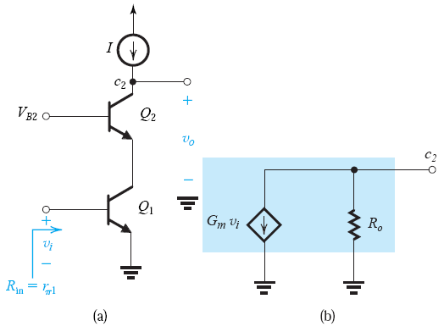
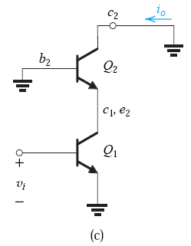
The BJT Cascode
Fig (a): the BJT cascode amplifier with an ideal current-source load.
Voltage V_{B2} is a dc bias voltage for the CB cascode transistor Q₂.
Objective is to determine the parameters G_{m} and R_{o} of the equivalent circuit of Fig (b).
As in case of MOS cascode, G_{m} is the short-circuit transconductance and can be determined from the circuit in Fig (c).

Slide 4
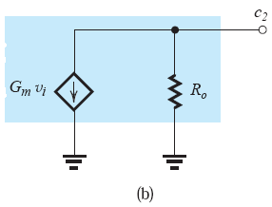
The BJT Cascode
Let’s determine the parameters G_{m} and R_{o} of the equivalent circuit.
The transconductance G_{m} = i_{o} / v_{i}
Replacing Q₁ and Q₂ with their hybrid- π equivalent-circuit models
Since g_{m2} ≫ (1/r_{π2}), 1/r_{o1}, and 1/r_{o2},
A node equation at c₂ is

Slide 5
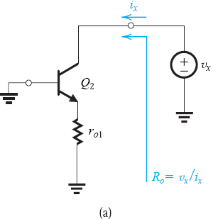
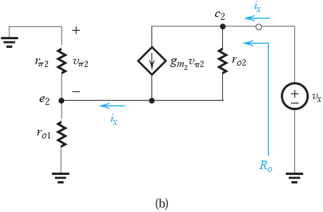
The BJT Cascode
Open-circuit voltage gain of the bipolar cascode:

Slide 6
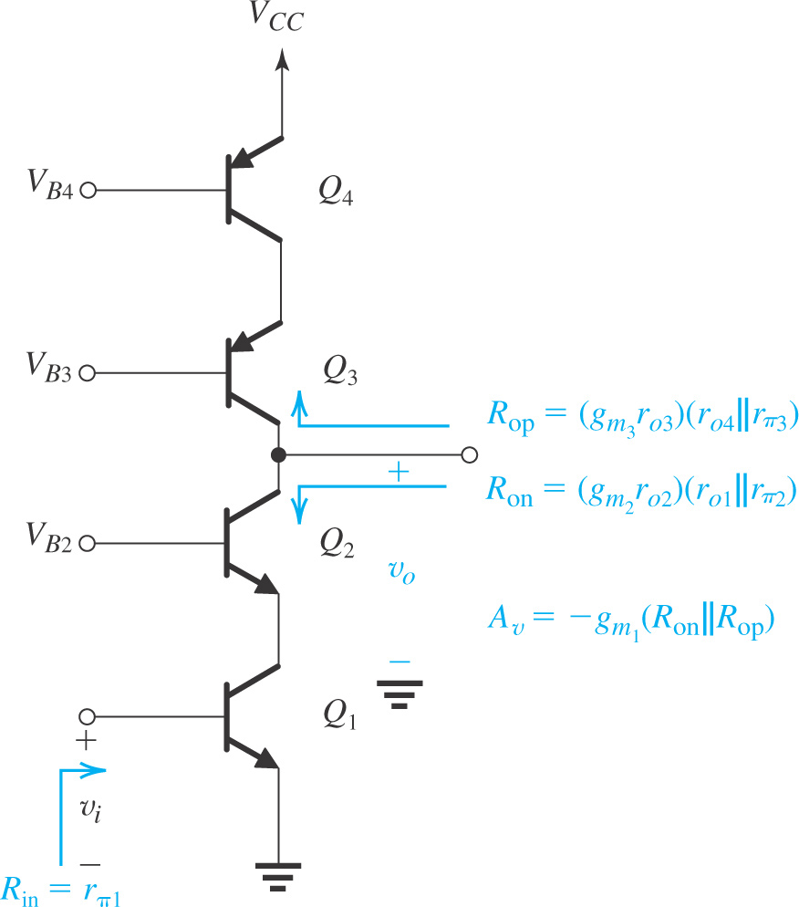
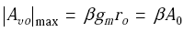
The BJT Cascode
which will be less than (g_{m}r_{o})² in magnitude. In fact, the maximum possible gain magnitude is obtained when r_{o} >> r_{π} and is given by
Note that to realize gains approaching this level, the current-source load must also be cascoded.
Figure: A BJT cascode amplifier with a cascode current source.

Slide 7
The Output Resistance of an Emitter-Degenerated CE Amplifier
(a)
As done in MOS case, one may adapt the expression for R_{o} derived from BJT cascode.
For the case of a CE amplifier with R_{e} as shown in Figure (a).
The output resistance is

Slide 8
Quiz 2.5
The simplified cascode amplifier used in the theory is shown in the Figure. The current I = 1mA. Two transistor are identical with β = 100 and V_{A} = 50V.
Determine r_{π1} and r_{π2}.
Determine r_{o1} and r_{o2}.
Determine g_{m1} and g_{m2}.
If the output resistance of the current source (I) is 200kΩ, plot the small signal equivalent circuit.
Compute the voltage gain v_{o}/v_{i}.
You submit your solution not later than March 20, 2020.
You can submit through Blackboard as informed by Mr. Huy on Blackboard announcement.

